Slide 1
Interface, Abstract, Inner Class
www.themegallery.com

Slide 2
Contents
1. INHERITANCE
2. ABSTRACTION
INTERFACE
INNER CLASS
TÀI LIỆU THAM KHẢO

Slide 3
1. Inheritance
Advantages:
One of the key benefits of inheritance is to minimize the amount of duplicate code in an application by sharing common code amongst several subclasses.
Reusability -- facility to use public methods of base class without rewriting the same Extensibility -- extending the base class logic as per business logic of the derived class
Data hiding -- base class can decide to keep some data private so that it cannot be altered by the derived class
Overriding--With inheritance, we will be able to override the methods of the base class so that meaningful implementation of the base class method can be designed in the derived class.

Slide 4
1. Inheritance
Disadvantages:
Main disadvantage of using inheritance is that the two classes (base and inherited class) get tightly coupled. This means one cannot be used independent of each other.
Also with time, during maintenance adding new features both base as well as derived classes are required to be changed. If a method signature is changed then we will be affected in both cases (inheritance & composition)
If a method is deleted in the "super class" or aggregate, then we will have to re-factor in case of using that method. Here things can get a bit complicated in case of inheritance because our programs will still compile, but the methods of the subclass will no longer be overriding superclass methods. These methods will become independent methods in their own right.

Slide 5
2. Abstract
Consider using abstract classes if any of these statements apply to your situation:
You want to share code among several closely related classes.
You expect that classes that extend your abstract class have many common methods or fields, or require access modifiers other than public (such as protected and private).
You want to declare non-static or non-final fields. This enables you to define methods that can access and modify the state of the object to which they belong.

Slide 6
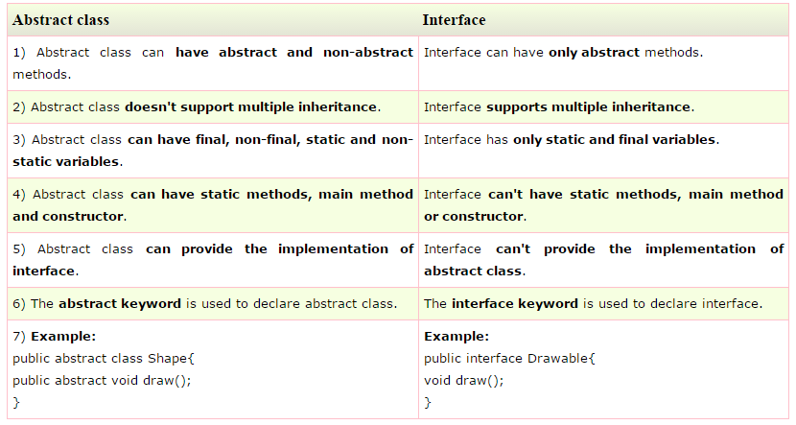
2. Abstract

Slide 7
3. Interface
Consider using interfaces if any of these statements apply to your situation:
You expect that unrelated classes would implement your interface. For example, the interfaces Comparable and Cloneable are implemented by many unrelated classes.
You want to specify the behavior of a particular data type, but not concerned about who implements its behavior.
You want to take advantage of multiple inheritance of type.

Slide 8

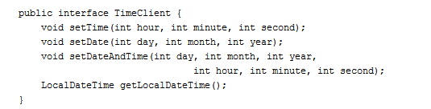
3. Interface
Default methods enable you to add new functionality to the interfaces of your libraries and ensure binary compatibility with code written for older versions of those interfaces

Slide 9
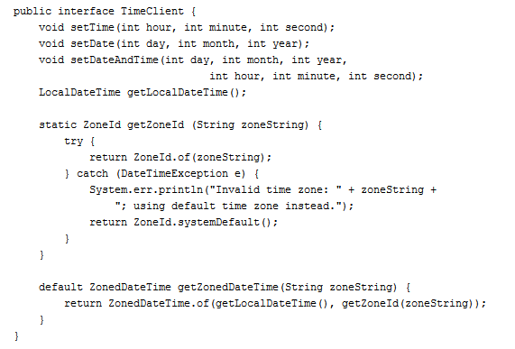
3. Interface
Following this modification to the TimeClient interface, you would also have to modify the class SimpleTimeClient and implement the method getZonedDateTime. However, rather than leaving getZonedDateTime as abstract (as in the previous example), you can instead define a default implementation

Slide 10
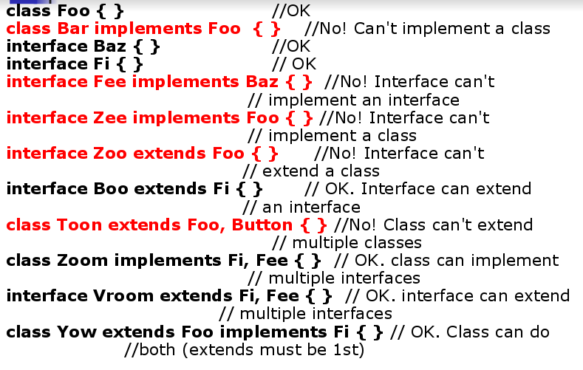
3. Interface

Slide 11
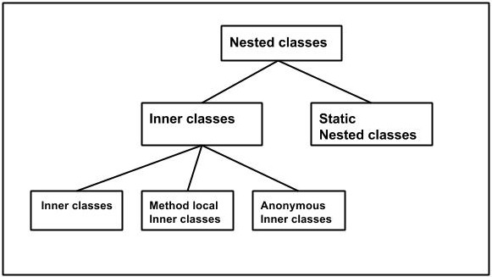
4. Inner class

Slide 12
Advantage
Code Optimization: It requires less code to write.

Slide 13
The .class File for an Inner Class
Compiling any class in Java produces a .class file named ClassName.class
Compiling a class with one (or more) inner classes causes both (or more) classes to be compiled, and produces two (or more) .class files
Such as ClassName.class and ClassName$InnerClassName.class

Slide 14
Definitions
Inner Class
Class defined within another class.
Instances have access to instance members of containing class.
Method-Local Inner Class
Class defined within a method.
Only available within the method.
Anonymous Classes
Classes with no class name!
Defined during reference declaration.
Nested Class
Class defined within another class.
Does not have access to instance members of containing class.

Slide 15
Referring to a Method of the Outer Class
If a method is invoked in an inner class
– If the inner class has no such method, then it is assumed to be an invocation of the method of that name in the outer class
– If both the inner and outer class have a method with the same name, then it is assumed to be an invocation of the method in the inner class
– If both the inner and outer class have a method with the same name, and the intent is to invoke the method in the outer class, then the following invocation must be used:
OuterClassName.this.methodName()

Slide 16
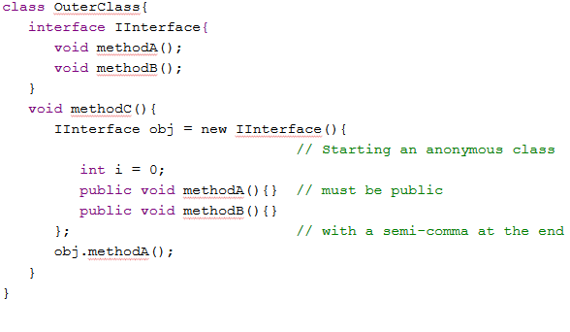
4. Inner class

Slide 17
Reference document
http://javarevisited.blogspot.com/2013/05/difference-between-abstract-class-vs-interface-java-when-prefer-over-design-oops.html#ixzz4IEwhEgpK

Slide 18
Thank You !
www.themegallery.com

